Slide 1







IOT WORKLOAD CHARACTERISATION IN NEXT GENERATION CLOUD SYSTEMS
Supervised by: Dr. Karan Mitra, Dr. Saguna Saguna,
Dr. Christer Åhlund
Presented by: Fatema Mirza

Slide 2


01
INTRODUCTION
What is IOT and Cloud and where do we use it?
fatmir-0@student.ltu.se

Slide 3






IOT EXPONENTIAL GROWTH & USAGE ^{[1,2]}
Smart Healthcare
Smart Agriculture
Smart Manufacturing
There has been an exponential growth of IOT in the past few years and expected to increase.
Smart Env. Monitoring
Some of the areas IoT is used in…
fatmir-0@student.ltu.se 8/05/2022 | 01
Notes:
The rapid increase in connected device (or IoT device) usage by commercial entities and consumers is changing the topography of the internet Connected devices have been designed to fulfill functional requirements (i.e. observe, control and maintain a piece of machinery remotely), but have often failed at incorporating proper green aspects in their design. The integration of the Internet of things and cloud computing has led to the emergence of new classes of applications ranging from smart healthcare, smart and precision agriculture, smart manufacturing to smart environmental monitoring. The rapid surge in the use of these applications is expected to generate massive amounts of data with different characteristics that are yet not studied.

Slide 4
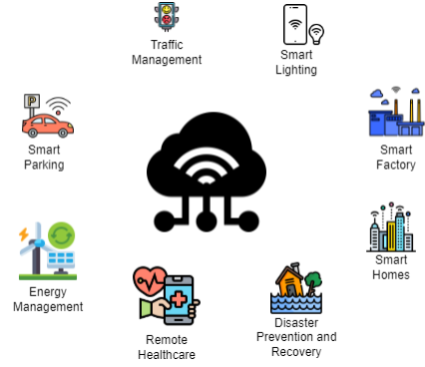
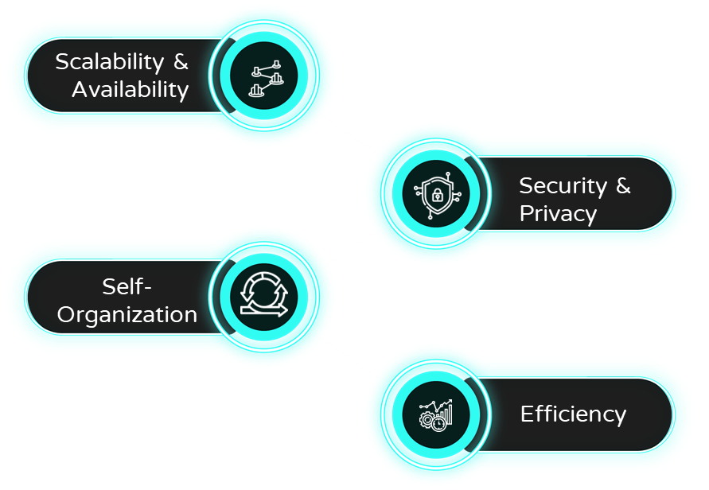
On demand self service
Broad Network Access
CLOUD COMPUTING … ^{[3,4,5]}
What is Cloud Computing?
Uses of Cloud Computing and IoT
Challenges of using Cloud Computing in IoT
Resource Pooling
Rapid Elasticity
Measured Service
Why Cloud Computing is needed for IoT
Supports Volume
Supports Velocity
Supports Elasticity
fatmir-0@student.ltu.se 8/05/2022 | 02

Slide 5

02
PROBLEM STATEMENT
The challenges, definite problem, and the hypothesized solution
fatmir-0@student.ltu.se

Slide 6

Problem Statement
We hypothesize that each IoT-enabled application may exhibit a diverse range of characteristics that if modelled correctly, may lead to efficient distributed systems. This thesis aims to study the traffic characteristics of an IoT-enabled healthcare application to build intelligent policies for efficient scalable IoT-cloud systems.
fatmir-0@student.ltu.se 8/05/2022 | 03

Slide 7

DOMAIN
EFFICIENCY
Problem Statement
SCALABILITY
IoT-enabled healthcare
In terms of response time and cost
Scalable IoT-cloud systems
fatmir-0@student.ltu.se 8/05/2022 | 04

Slide 8

03
AIMS & RESEARCH QUESTIONS
fatmir-0@student.ltu.se

Slide 9
RQ1.
RQ2.
RESEARCH QUESTIONS
RQ3.
A1.
C1.
Analyse IoT traffic data characteristics from a real use case in SSiO - data generated from the IoT system of elder citizens home in Skelleftea, Sweden.
What are the traffic characteristics of an IoT Healthcare System?
A comprehensive analysis of how the real life IoT healthcare application workload can be modelled
A2.
C2.
What analytical model best approximates IoTHA traffic prediction/forecasting?
THESIS CONTRIBUTION
THESIS AIM
A comprehensive analysis of how the real life IoT healthcare application workload can be predicted
Build analytical models to depict the traffic workload and prediction from the IoTHA
A3.
How do we integrate green elastic policies into IoTHA in the Cloud environment?
C3.
Utilise the analytical model to implement and test the load balancing algorithm for elasticity and cost in cloud scenario.
A load balancing algorithm that can be utilised to use the real life workload prediction algorithm to select and deselect in advance the best virtual machines for a cloud platform and optimize response time and cost
fatmir-0@student.ltu.se 8/05/2022 | 05

Slide 10

04
METHODOLOGY
The macro and micros of methodology
fatmir-0@student.ltu.se

Slide 11
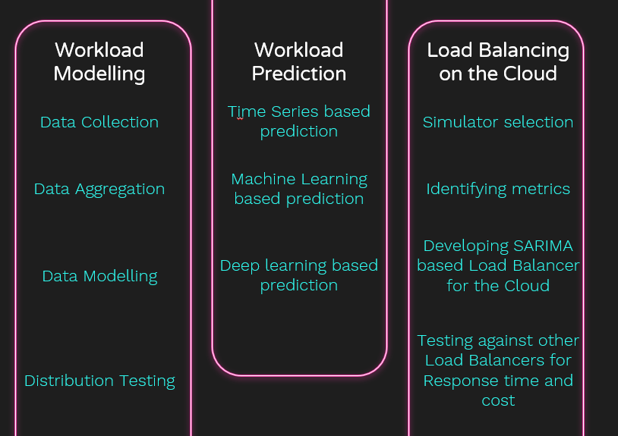
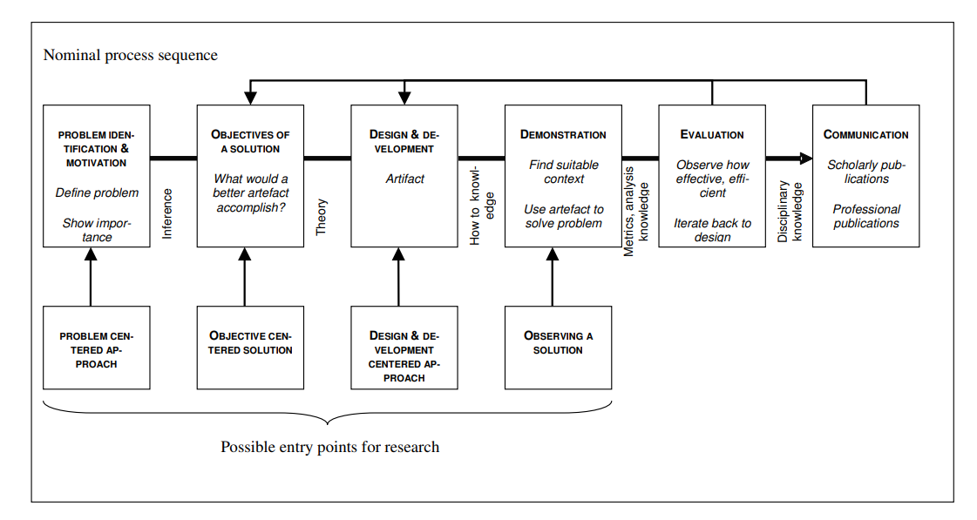
MACROMETHODOLOGY ^{[6]}
MICROMETHODOLOGY
Design Science Research Methodology
fatmir-0@student.ltu.se 8/05/2022 | 06

Slide 12

05
BACKGROUND STUDY
Understand existing work done in this field
fatmir-0@student.ltu.se

Slide 13

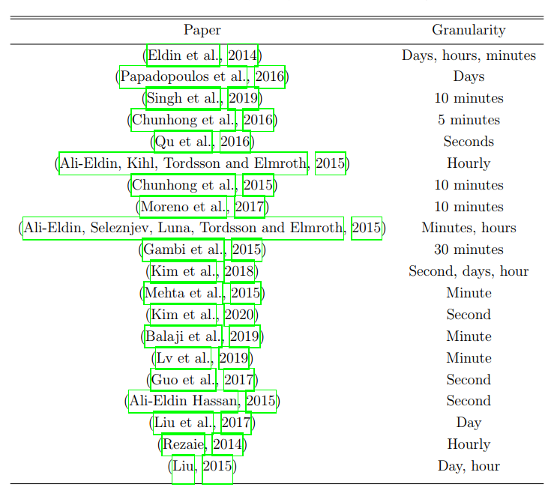
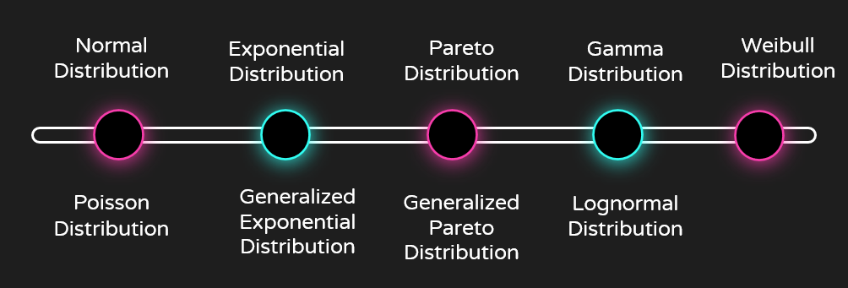
WM1. ^{[7,8,9]}
Selected
Wikipedia workload modelling
New York City Taxi Trip Data Workload modelling
Microsoft T-Drive Trajectory Dataset Workload modelling
Chicago Taxi Trips Dataset Workload modelling
WORKLOAD MODELLING
15 minutes
WM2.
Granularity Testing
WM3. ^{[10,11,12]}
Distribution Testing
fatmir-0@student.ltu.se 8/05/2022 | 07

Slide 14
WP1. ^{[7, 13,14,15,16,18]}
WP2. ^{[14,17,18]}
WORKLOAD PREDICTION
WP3. ^{[19,20,21]}
Holt-Winters, AR, ARMA, ARIMA, GARCH, Exponential Smoothing, ETS.
Time Series based Prediction
Linear and Gaussian SVMs, Decision Tree, Random Forest, Gradient Boosting, Extra Trees
Machine Learning based prediction
Deep Learning based prediction
RNN, LSTM, Bi-LSTM, DNN
fatmir-0@student.ltu.se 8/05/2022 | 08

Slide 15
WORKLOAD PREDICTION
Selected
Selected
Selected
SARIMA
Random Forest
LSTM
fatmir-0@student.ltu.se 8/05/2022 | 09

Slide 16
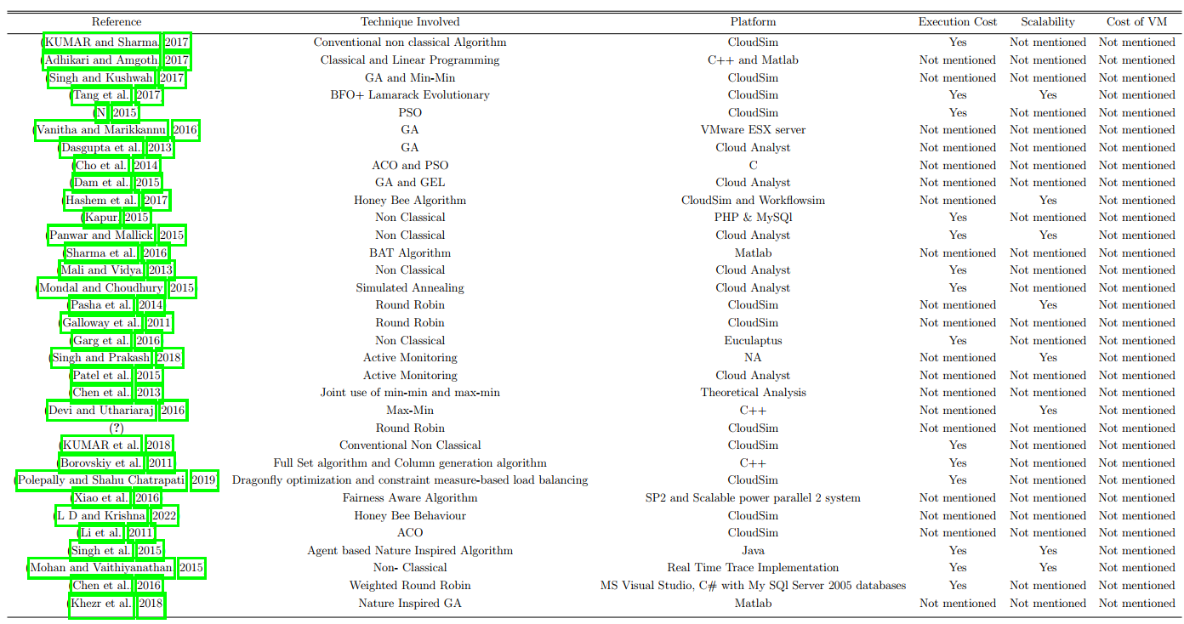
LB1.
LB2.
LOAD BALANCING ON THE CLOUD
LB3.
Simulator Selection
Metrics Identification
Other Load Balancers
fatmir-0@student.ltu.se 8/05/2022 | 10

Slide 17

Simulator Selection
Metric Identification
Other Load Balancers
LOAD BALANCING ON THE CLOUD
CloudSim Plus
CloudAnalyst
Response Time
Cost of VM
Active Load Balancer
Round Robin Load Balancer
fatmir-0@student.ltu.se 8/05/2022 | 11

Slide 18

06
DATASET
Data collection source
fatmir-0@student.ltu.se

Slide 19
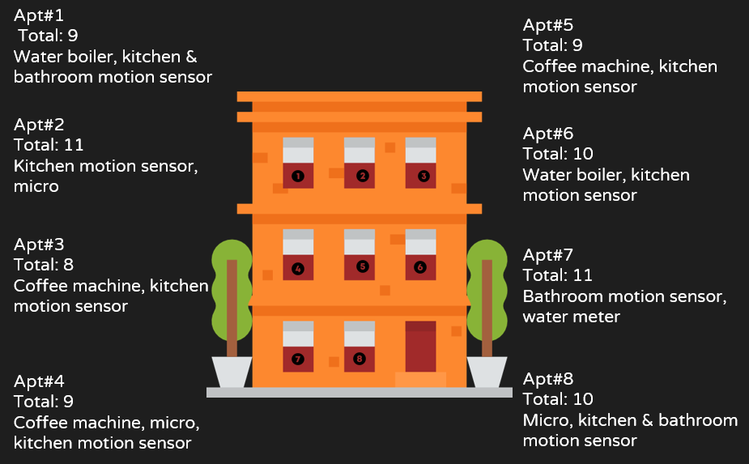
DATASET ^{[23]}
fatmir-0@student.ltu.se 8/05/2022 | 12

Slide 20

07
WORKLOAD MODELLING
How to model the workload
fatmir-0@student.ltu.se

Slide 21
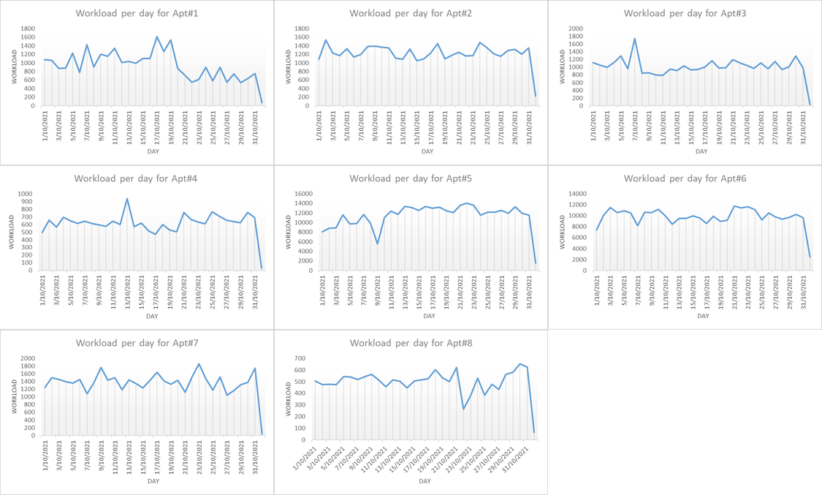
DAILY MODELLING APT. WISE
fatmir-0@student.ltu.se 8/05/2022 | 13

Slide 22
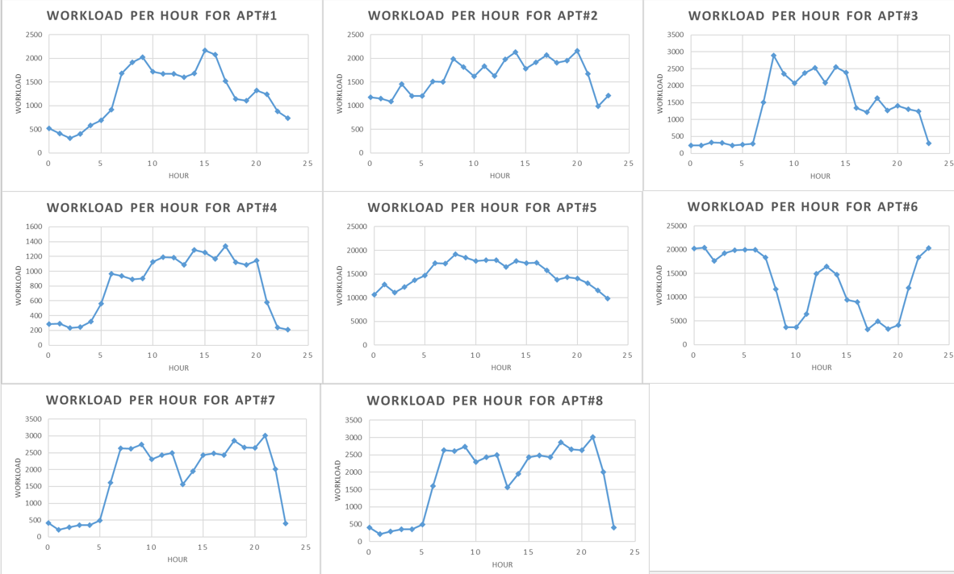
HOURLY MODELLING APT. WISE
fatmir-0@student.ltu.se 8/05/2022 | 14

Slide 23
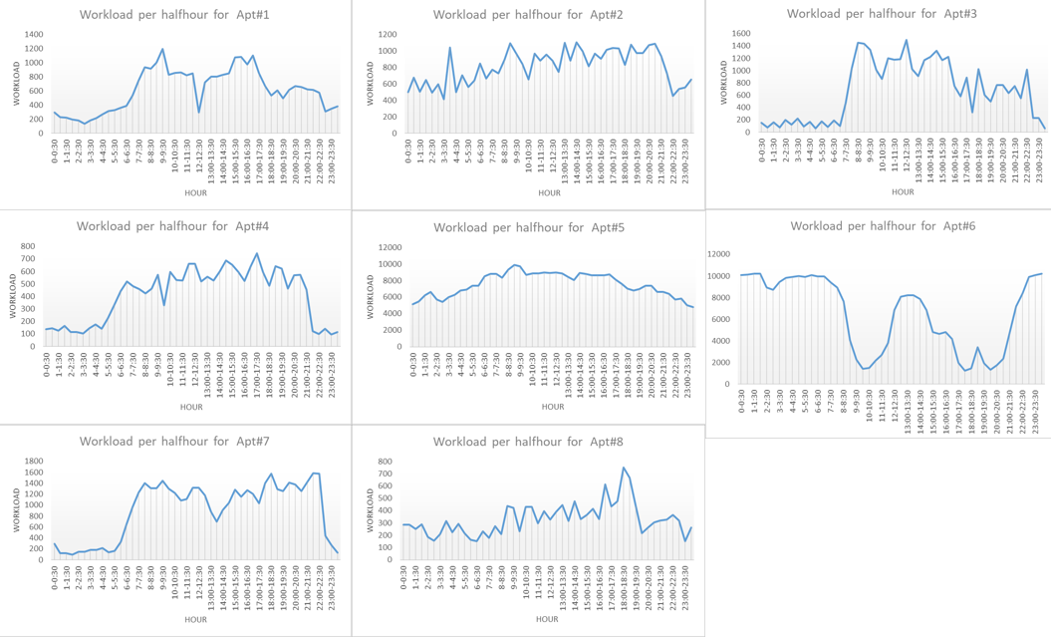
HALF HOURLY MODELLING APT. WISE
fatmir-0@student.ltu.se 8/05/2022 | 15

Slide 24
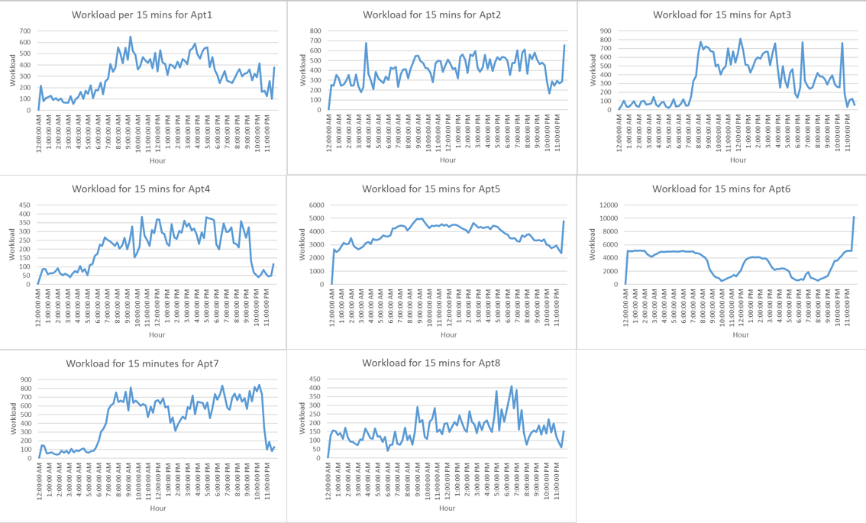
QUARTER HOURLY MODELLING APT. WISE
fatmir-0@student.ltu.se 8/05/2022 | 16

Slide 25
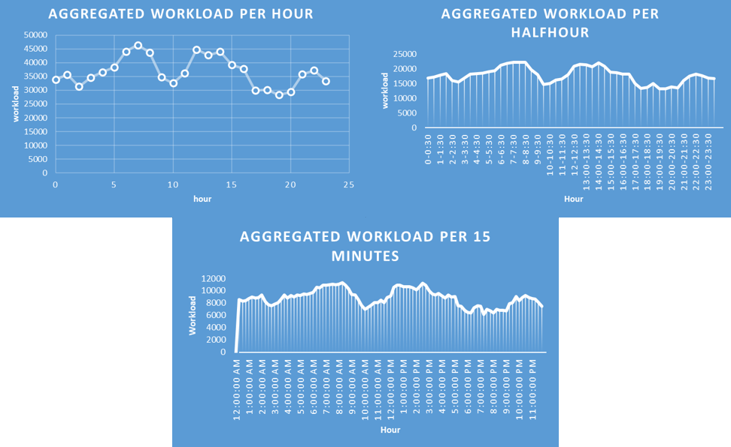
AGGREGATED MODELLING FOR OCT. 2021
fatmir-0@student.ltu.se 8/05/2022 | 17

Slide 26
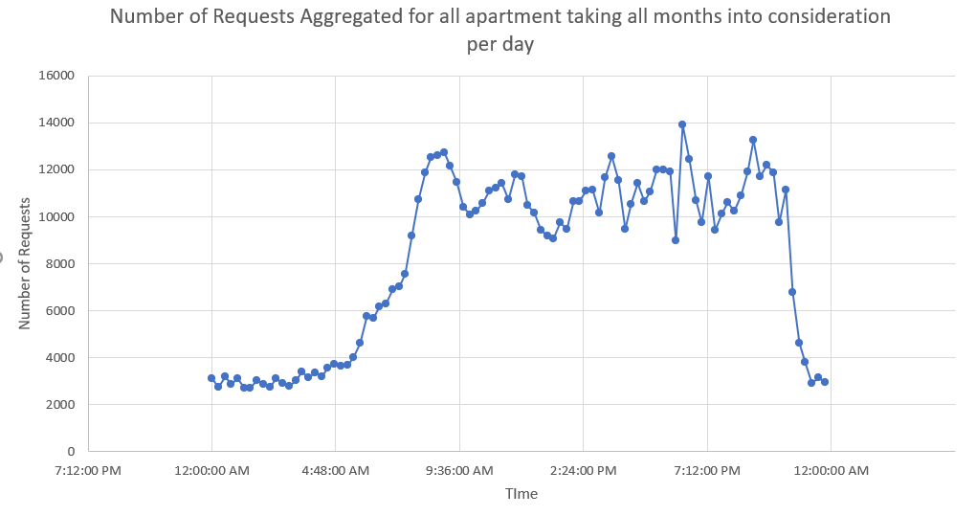
AGGREGATED QUARTER HOURLY MODELLING
15 minutes
fatmir-0@student.ltu.se 8/05/2022 | 18

Slide 27
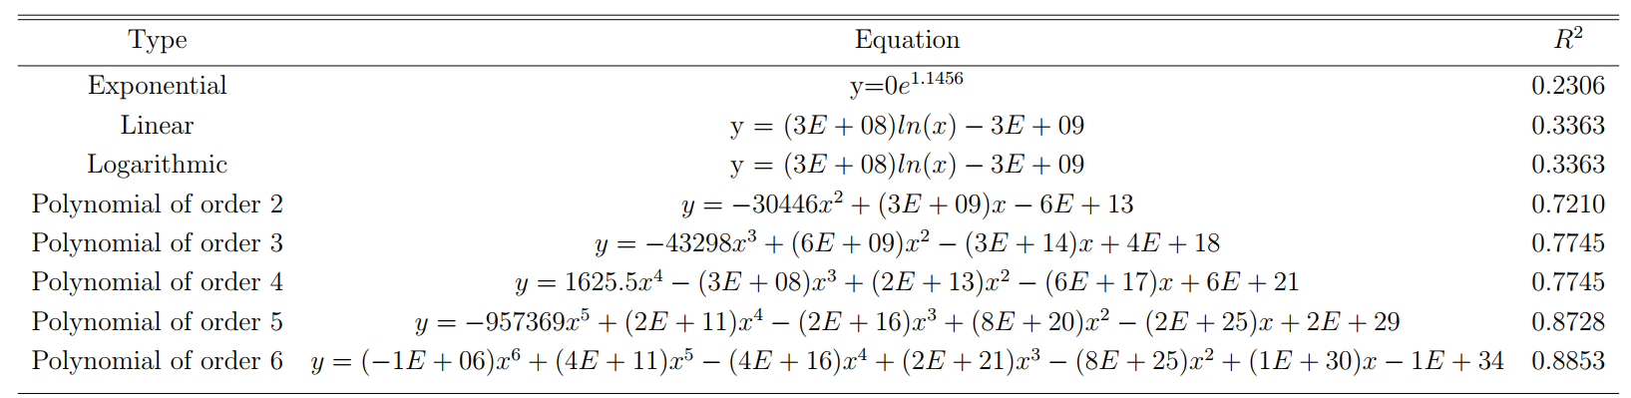
TRENDLINE ANALYSIS
fatmir-0@student.ltu.se 8/05/2022 | 19

Slide 28
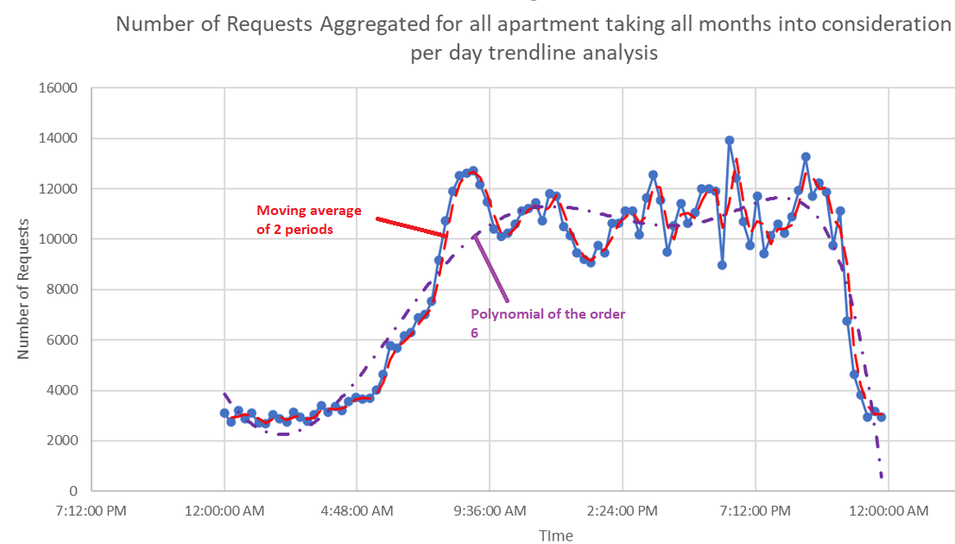
TRENDLINE ANALYSIS
15
fatmir-0@student.ltu.se 8/05/2022 | 20

Slide 29

08
WORKLOAD PREDICTION
How to predict using the workload
fatmir-0@student.ltu.se

Slide 30




ARIMA
SARIMA
ALGORITHMS CONSIDERED FOR WORKLOAD PREDICTION
Random Forest
LSTM
fatmir-0@student.ltu.se 8/05/2022 | 22

Slide 31
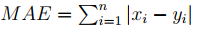
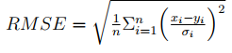
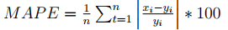
ACCURACY METRICS
fatmir-0@student.ltu.se 8/05/2022 | 28

Slide 32

09
TESTBED DESIGN FOR SIMULATION OF LOAD BALANCING ON CLOUD USING SARIMALB
Flow of how the load balancing will work on SARIMA
fatmir-0@student.ltu.se

Slide 33
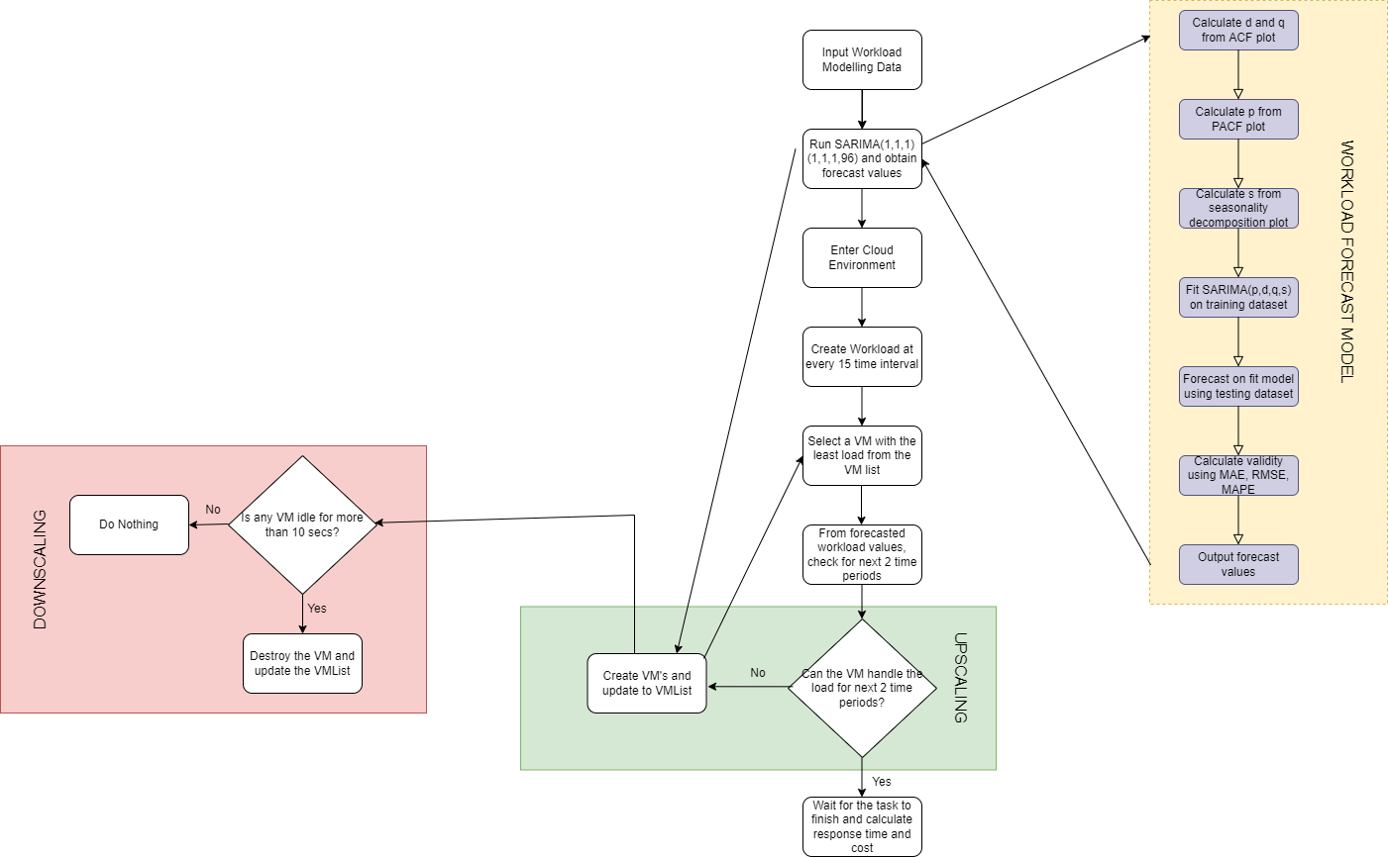
fatmir-0@student.ltu.se 17/12/2021 | 03

Slide 34
10
RESULTS FOR DATASET AND WORKLOAD MODELLING
fatmir-0@student.ltu.se

Slide 35
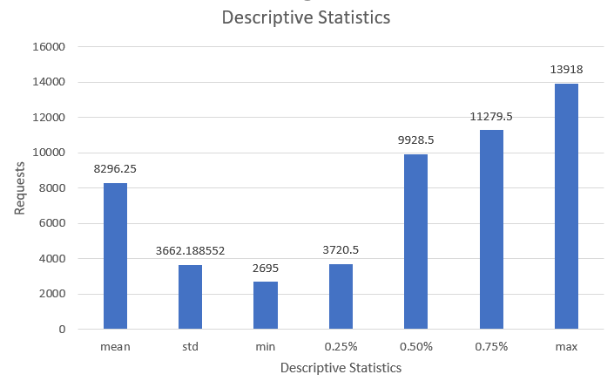
DESCRIPTIVE STATISTICS
fatmir-0@student.ltu.se 8/05/2022 | 24

Slide 36
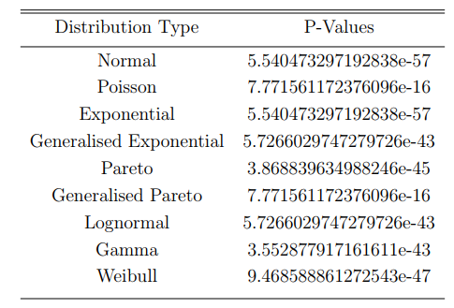

Kolmogorov–Smirnov test
TEST FOR DISTRIBUTION
compares the data distribution with a known distribution and checks whether they are the same
fatmir-0@student.ltu.se 8/05/2022 | 25

Slide 37
11
RESULTS FOR WORKLOAD PREDICTION
fatmir-0@student.ltu.se

Slide 38
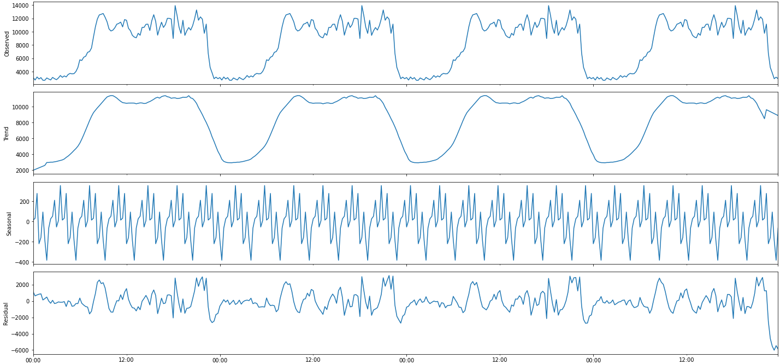
DECOMPOSITION OF THE DATASET
fatmir-0@student.ltu.se 8/05/2022 | 26

Slide 39
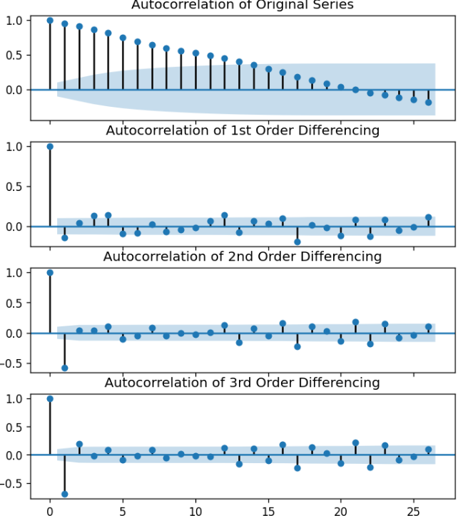
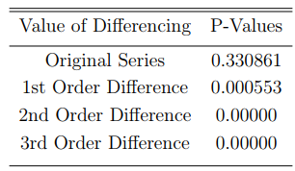
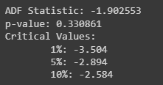
IS THE DATA STATIONARY?
AUTOCORRELATION PLOT
ADF STAT. FOR DIFFERENCING
The value of d = 1 for this series
The value of q = 1 for this series
fatmir-0@student.ltu.se 8/05/2022 | 27

Slide 40
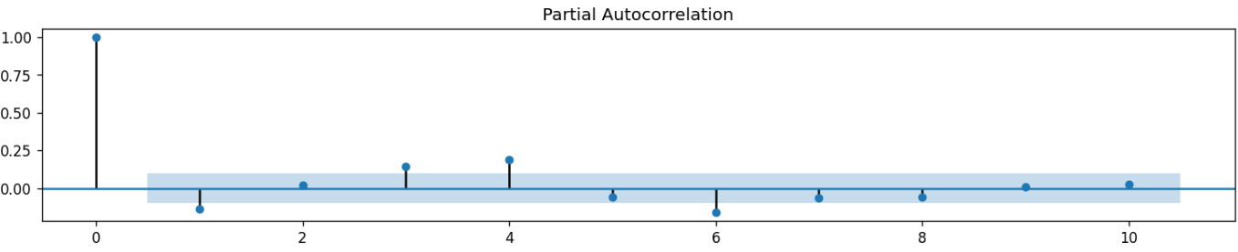
PARTIAL AUTOCORRELATION PLOT
The value of p = 1 for this series
fatmir-0@student.ltu.se 8/05/2022 | 28

Slide 41
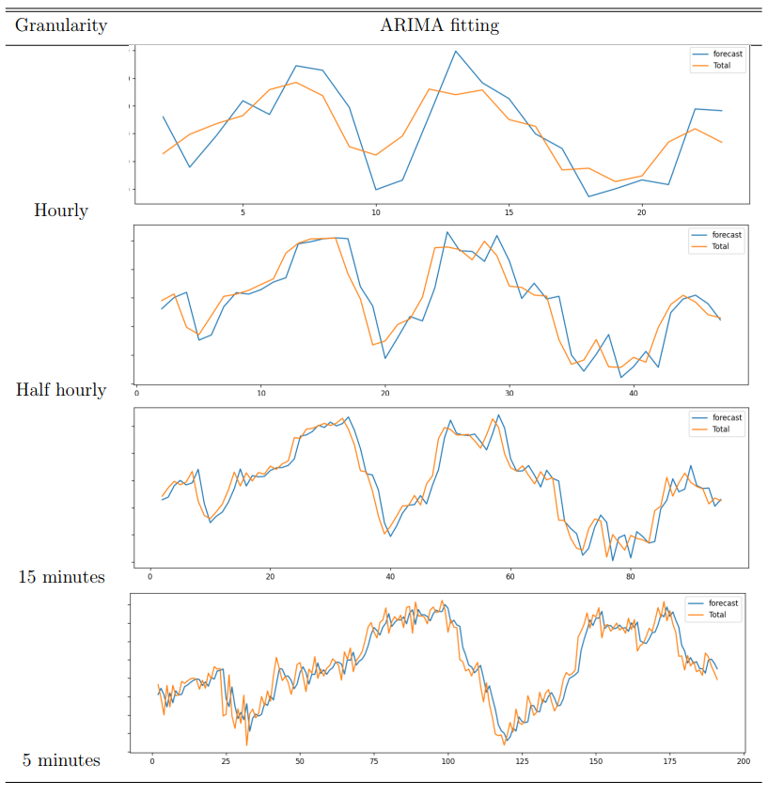
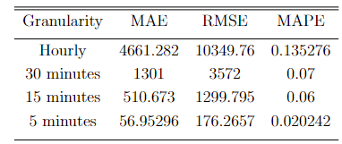
FITTING ARIMA(1,1,1)
Summary of errors for different granularity for ARIMA fitting
8/05/2022 | 29

Slide 42
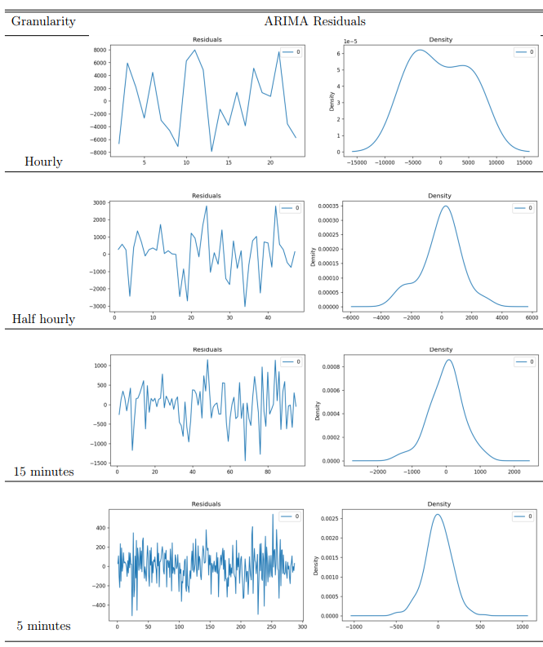
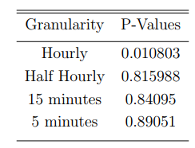
FITTING ARIMA(1,1,1) RESIDUALS
Summary of Ljung-Box test for diﬀerent granularity for ARIMA fitting
8/05/2022 | 30

Slide 43
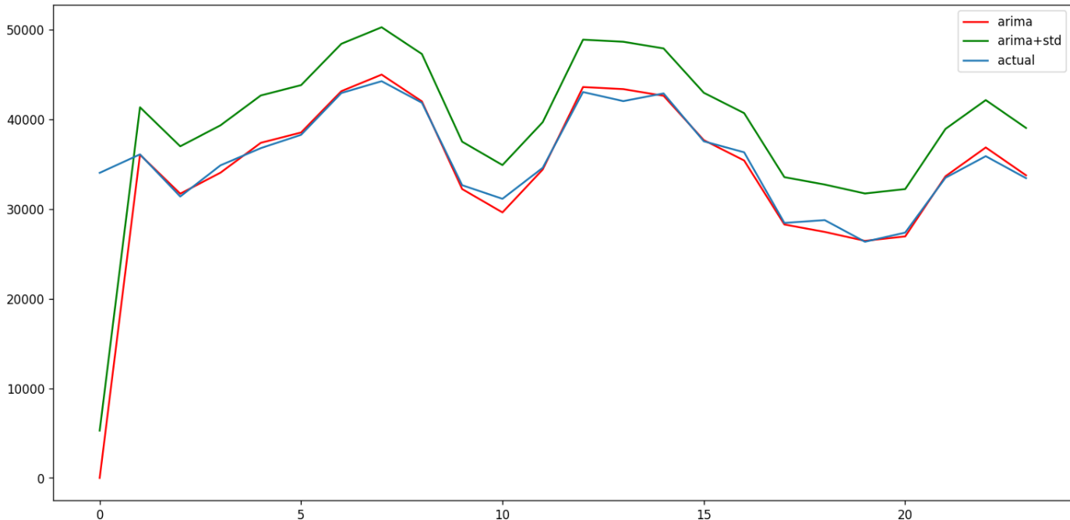
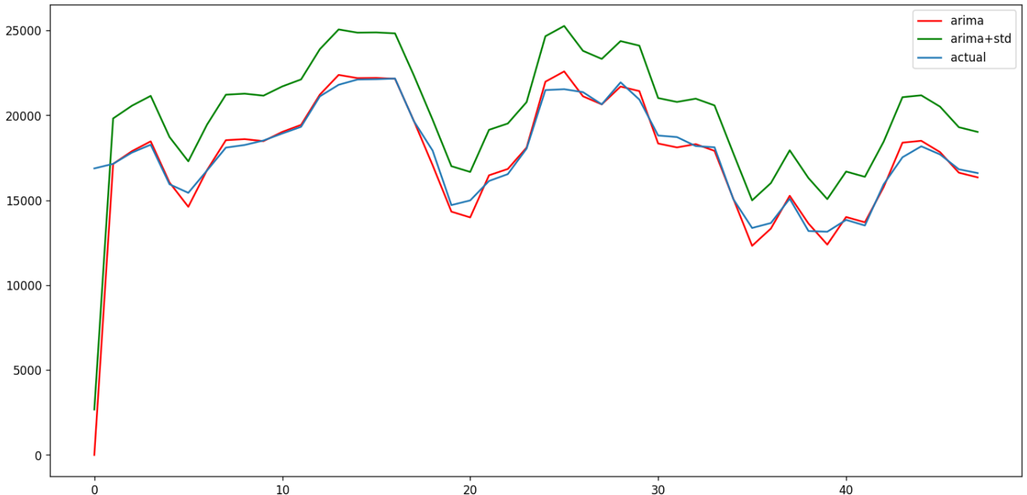
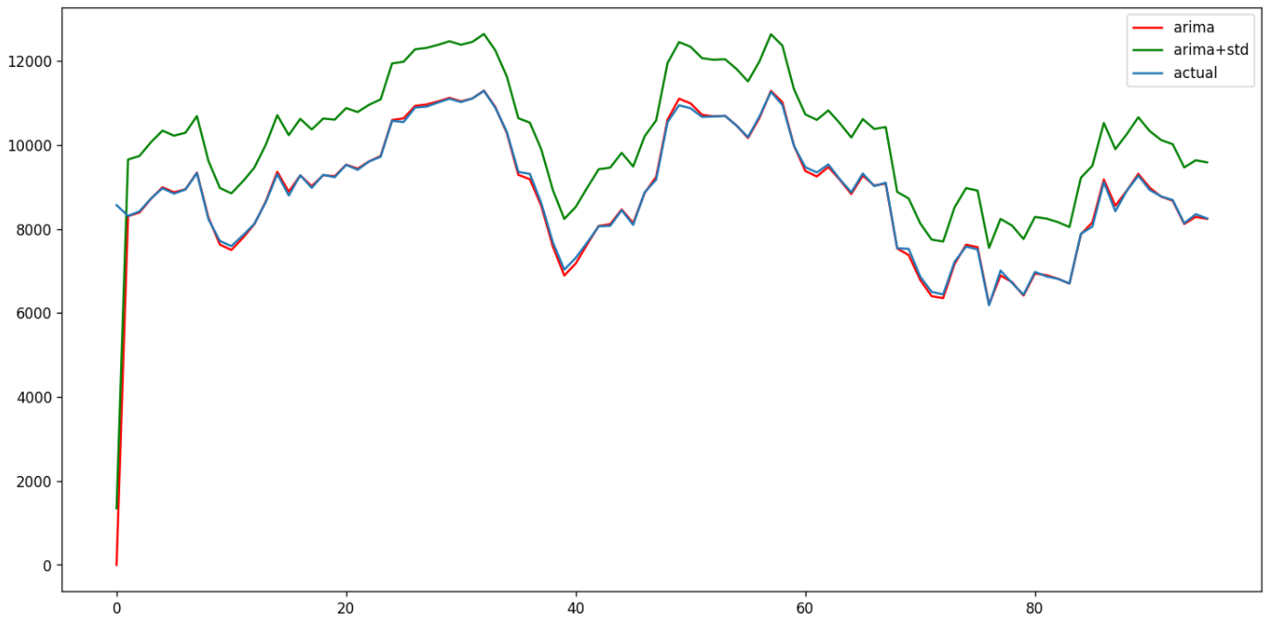
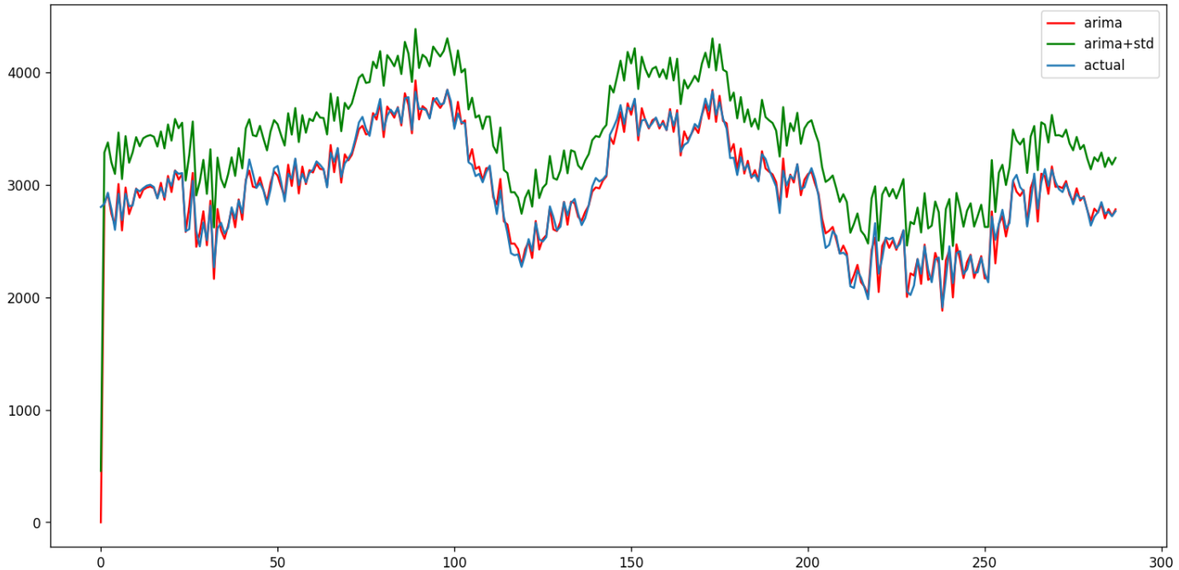
Hourly with ARIMA + STD of the dataset
Halfhourly with ARIMA + STD of the dataset
MITIGATING THE UNDERPROVISIONING
Quarter Hourly with ARIMA + STD of the dataset
5 minutes with ARIMA + STD of the dataset
fatmir-0@student.ltu.se 8/05/2022 | 31

Slide 44
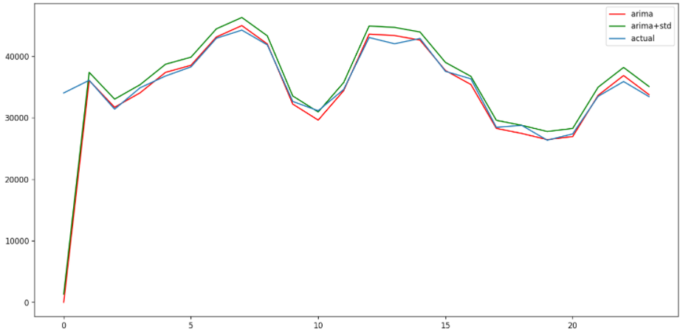
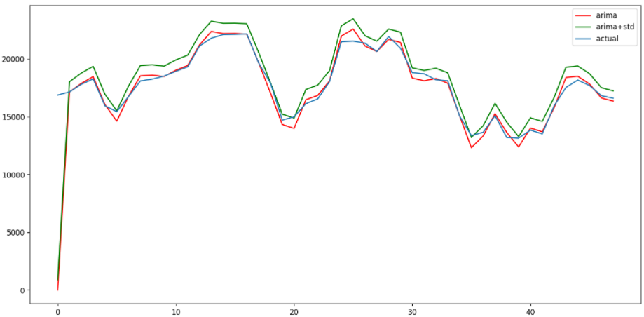
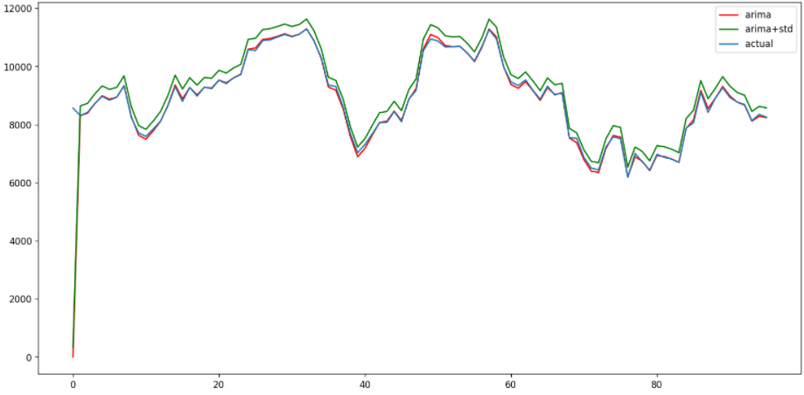
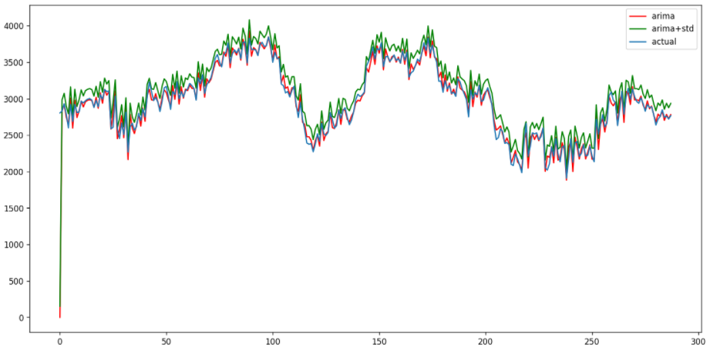
Hourly with ARIMA + STD/4 of the dataset
Halfhourly with ARIMA + STD of the dataset
MITIGATING THE UNDERPROVISIONING
Quarter Hourly with ARIMA + STD/3 of the dataset
5 minutes with ARIMA + STD of the dataset
fatmir-0@student.ltu.se 8/05/2022 | 33

Slide 45
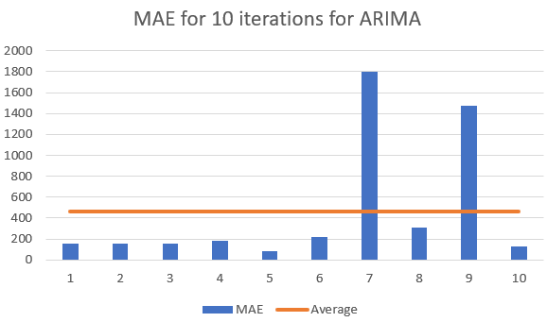
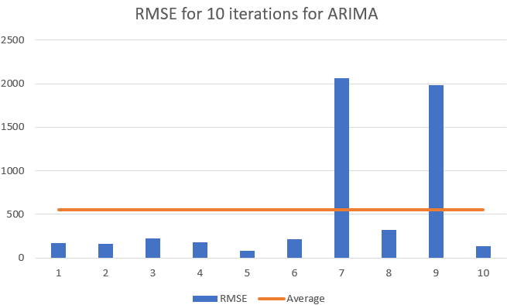
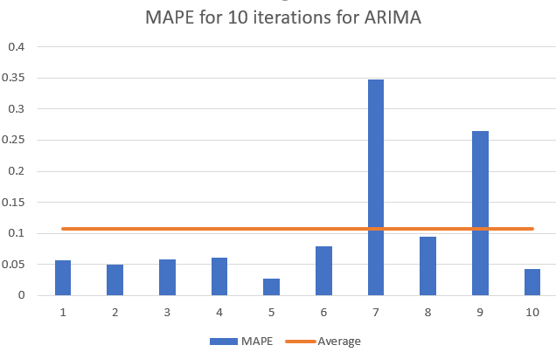
Summary of MAE, RMSE & MAPE for
ARIMA forecasting for 2 time periods
fatmir-0@student.ltu.se 8/05/2022 | 34

Slide 46
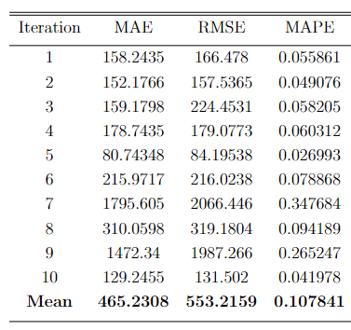
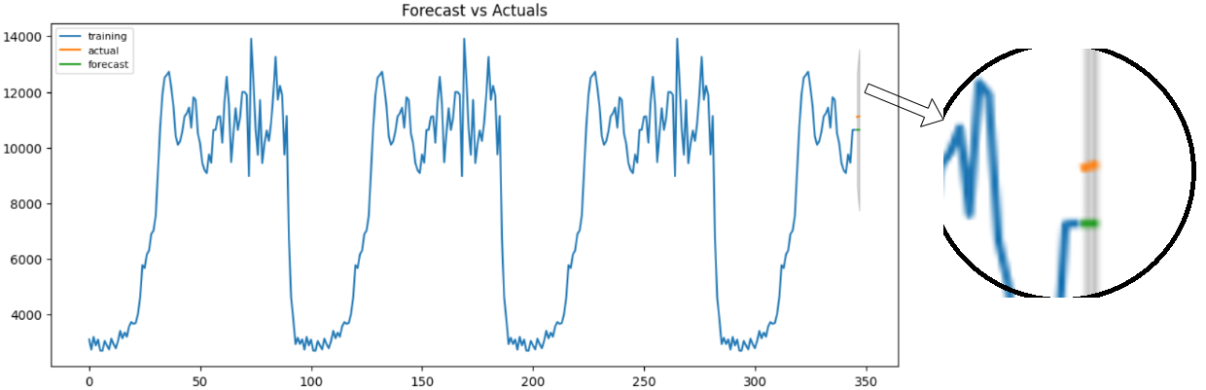
Summary of MAE, RMSE & MAPE for ARIMA forecasting for 2 time periods
fatmir-0@student.ltu.se 8/05/2022 | 35

Slide 47
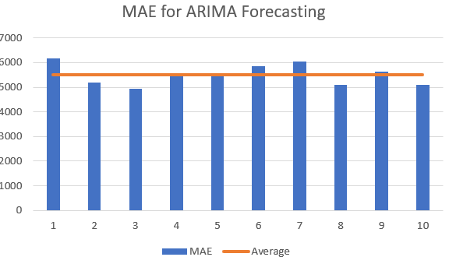
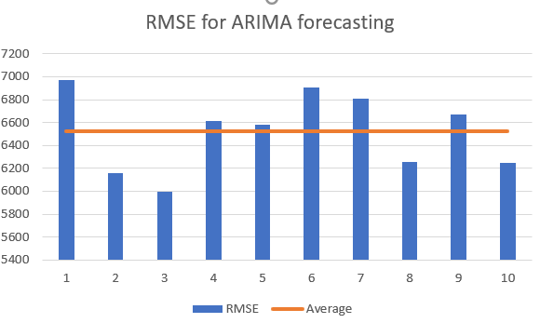
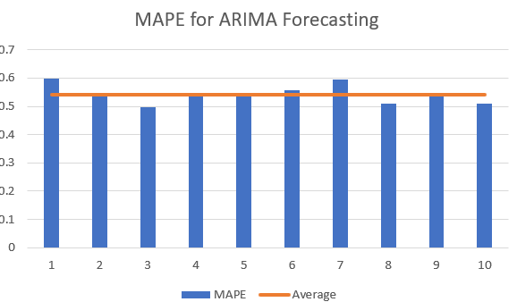
Summary of MAE, RMSE & MAPE for ARIMA forecasting for more time periods
fatmir-0@student.ltu.se 8/05/2022 | 36

Slide 48
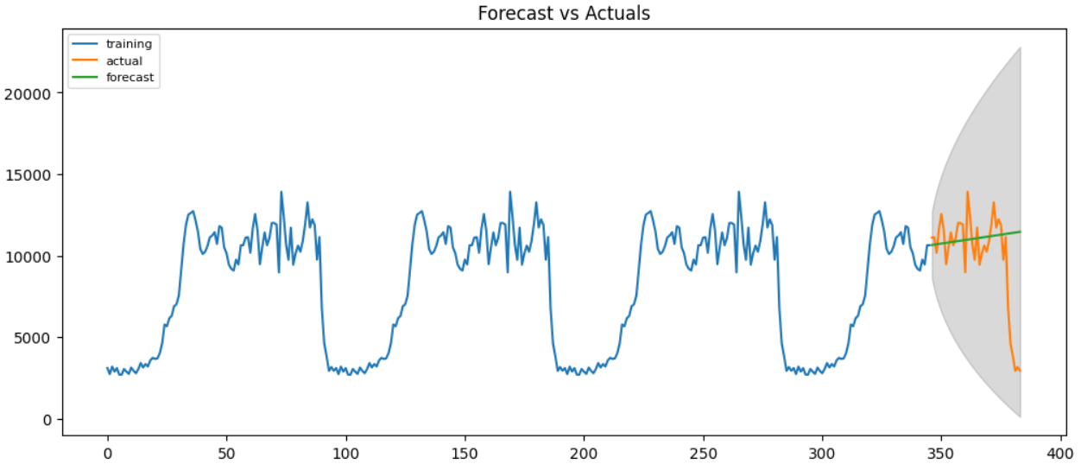
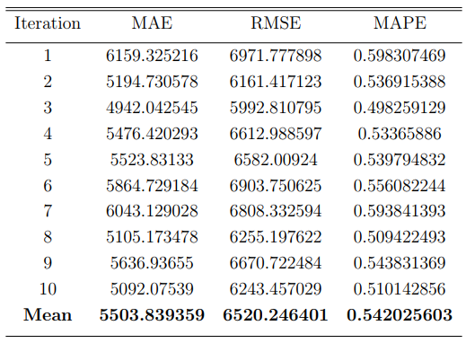
Summary of MAE, RMSE & MAPE for ARIMA forecasting for more time periods
fatmir-0@student.ltu.se 8/05/2022 | 37

Slide 49
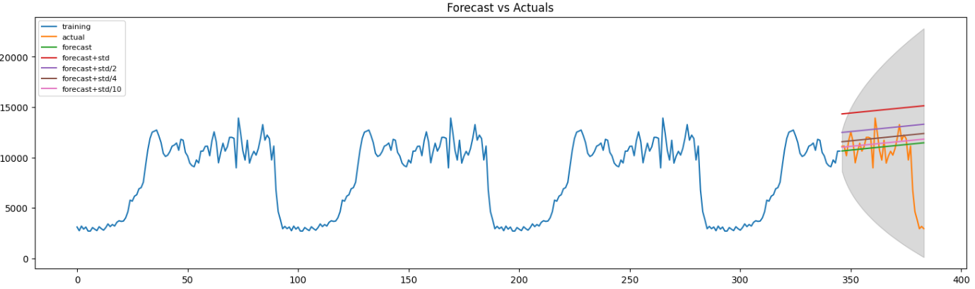
Summary of ARIMA forecasting for more
time periods with std. dev
fatmir-0@student.ltu.se 8/05/2022 | 38

Slide 50



Summary of MAE, RMSE & MAPE for SARIMA forecasting for 2 time periods for seasonal order of 15
fatmir-0@student.ltu.se 8/05/2022 | 39

Slide 51


Summary of MAE, RMSE & MAPE for SARIMA forecasting for 2 time periods for seasonal order of 15
fatmir-0@student.ltu.se 8/05/2022 | 40

Slide 52



Summary of MAE, RMSE & MAPE for SARIMA forecasting for 2 time periods for seasonal order of 30
fatmir-0@student.ltu.se 8/05/2022 | 41

Slide 53


Summary of MAE, RMSE & MAPE for SARIMA forecasting for 2 time periods for seasonal order of 30
fatmir-0@student.ltu.se 8/05/2022 | 42

Slide 54



Summary of MAE, RMSE & MAPE for SARIMA forecasting for 2 time periods for seasonal order of 96
fatmir-0@student.ltu.se 8/05/2022 | 43

Slide 55


Summary of MAE, RMSE & MAPE for SARIMA forecasting for 2 time periods for seasonal order of 96
fatmir-0@student.ltu.se 8/05/2022 | 44

Slide 56


Summary of Residual Analysis for SARIMA forecasting for 2 time periods
Summary of Ljung-Box test for diﬀerent seasonality orders for SARIMA
fatmir-0@student.ltu.se 8/05/2022 | 45

Slide 57



Summary of MAE, RMSE & MAPE
for SARIMA forecasting for more time periods for seasonal order of 96
fatmir-0@student.ltu.se 8/05/2022 | 46

Slide 58


Summary of MAE, RMSE & MAPE
for SARIMA forecasting for more time
periods for seasonal order of 96
fatmir-0@student.ltu.se 8/05/2022 | 47

Slide 59



Summary of MAE, RMSE & MAPE for Random Forest
fatmir-0@student.ltu.se 8/05/2022 | 48

Slide 60


Summary of MAE, RMSE & MAPE for Random Forest
fatmir-0@student.ltu.se 8/05/2022 | 48

Slide 61



Summary of MAE, RMSE & MAPE for LSTM
fatmir-0@student.ltu.se 8/05/2022 | 49

Slide 62

Summary of MAE, RMSE & MAPE for LSTM
fatmir-0@student.ltu.se 8/05/2022 | 50

Slide 63



Comparison of MAE, RMSE & MAPE for all algorithms for more time periods
fatmir-0@student.ltu.se 8/05/2022 | 51

Slide 64


Comparison of MAE, RMSE & MAPE for ARIMA & SARIMA for 2 time periods
seasonality orders for SARIMA
fatmir-0@student.ltu.se 8/05/2022 | 52

Slide 65
12
RESULTS FOR SIMULATION OF LOAD BALANCING ON CLOUD USING SARIMALB
fatmir-0@student.ltu.se

Slide 66

Comparison of the means Response time
and cost for Diﬀerent Load Balancers for Diﬀerent number of VM’s
fatmir-0@student.ltu.se 8/05/2022 | 53

Slide 67


Comparison of the means Response time
and cost for Diﬀerent Load Balancers for Diﬀerent number of VM’s
fatmir-0@student.ltu.se 8/05/2022 | 54

Slide 68
13
SUSTAINABILITY ANALYSIS
A walkthrough the different aspects of sustainability of the thesis
fatmir-0@student.ltu.se

Slide 69


SUSTAINABILITY ANALYSIS ^{[24, 25,26]}
fatmir-0@student.ltu.se 17/12/2021 | 11

Slide 70
14
DELIMITATION
Threat to the validity of the results
fatmir-0@student.ltu.se

Slide 71
D3.
D1.
DELIMITATIONS
D2.
Focused only on IoT Healthcare Applications
Implemented on a simulation – not on a real system
Processing and writing time into database is not considered
fatmir-0@student.ltu.se 8/05/2022 | 56

Slide 72
15
FUTURE WORK
Possible extension avenues for the future
fatmir-0@student.ltu.se

Slide 73
F3.
F1.
FUTURE WORK
F2.
Include Queueing theory
Real costing model
F4.
Processing and writing time into database
Deployment on real cloud
fatmir-0@student.ltu.se 8/05/2022 | 57

Slide 74
16
CONCLUSION
Are all the research questions answered?
fatmir-0@student.ltu.se

Slide 75

RQ1.
RQ2.
RQ3.
CONCLUSION
What are the traffic characteristics of an IoT Healthcare System?
What analytical model best approximates IoTHA traffic prediction/forecasting?
How do we integrate green elastic policies for cloud deployment into IoTHA?
fatmir-0@student.ltu.se 8/05/2022 | 58

Slide 76

Thank you! Tack så mycket
Any Questions?
fatmir-0@student.ltu.se

Slide 77
References
[1] Ryan, Peter & Watson, Richard. (2017). Research Challenges for the Internet of Things: What Role Can OR Play?. Systems. 5. 24. 10.3390/systems5010024.
[2] Nizetic, Sandro & Šolić, Petar & González-de-Artaza, Diego & Patrono, Luigi. (2020). Internet of Things (IoT): Opportunities, issues and challenges towards a smart and sustainable future. Journal of Cleaner Production. 274. 122877. 10.1016/j.jclepro.2020.122877.
[3] Mill, P. and Grance, T. (2011), ‘The nist defnition of cloud computing’. https://nvlpubs.nist.gov/nistpubs/Legacy/SP/nistspecialpublication800-145.pdf.
[4] Askary, Zareef & Kumar, Ravinder. (2020). Cloud Computing in Industries: A Review. 10.1007/978-981-15-1071-7_10.
[5] Imran, Muhammad & Zoha, Ahmed & Zhang, Lei & Abbasi, Qammer. (2020). Grand Challenges in IoT and Sensor Networks. Frontiers in Communications and Networks. 1. 10.3389/frcmn.2020.619452.
[6] Peffers, Ken & Tuunanen, Tuure & Gengler, Charles & Rossi, Matti & Hui, Wendy & Virtanen, Ville & Bragge, Johanna. (2006). The design science research process: A model for producing and presenting information systems research. Proceedings of First International Conference on Design Science Research in Information Systems and Technology DESRIST.
[7] Calheiros, Rodrigo & Masoumi, Enayat & Ranjan, R. & Buyya, Rajkumar. (2014). Workload Prediction Using ARIMA Model and Its Impact on Cloud Applications' QoS. IEEE Transactions on Cloud Computing. 3. 1-1. 10.1109/TCC.2014.2350475.
[8] Eldin, Ahmed & Rezaie, Ali & Mehta, Amardeep & Razroev, Stanislav & Luna, Sara & Seleznjev, Oleg & Tordsson, Johan & Elmroth, Erik. (2014). How will Your Workload Look Like in 6 Years? Analyzing Wikimedia's Workload. Proceedings - 2014 IEEE International Conference on Cloud Engineering, IC2E 2014. 349-354. 10.1109/IC2E.2014.50.
[9] Tadakamalla, Uma & Menascé, Daniel. (2019). Characterization of IoT Workloads. 10.1007/978-3-030-23374-7_1.
[10] Majumdar, Chitradeep & López-Benítez, Miguel & Merchant, Shabbir. (2020). Real Smart Home Data-Assisted Statistical Traffic Modeling for the Internet of Things. IEEE Internet of Things Journal. PP. 1-1. 10.1109/JIOT.2020.2969318.
[11] López-Benítez, Miguel & Majumdar, Chitradeep & Merchant, Shabbir. (2020). Aggregated Traffic Models for Real-World Data in the Internet of Things. IEEE Wireless Communications Letters. PP. 1-1. 10.1109/LWC.2020.2980272.
[12] Metzger, F., Hossfeld, T., Bauer, A., Kounev, S. and Heegaard, P. (2019), ‘Modeling of aggregated iot trafc and its application to an iot cloud’, Proceedings of the IEEE 107, 679 – 694.
[13] Adegboyega, Abiola. (2017). Time-series models for cloud workload prediction: A comparison. 298-307. 10.23919/INM.2017.7987292.
[14] Jayakumar, Vinodh Kumaran & Lee, Jaewoo & Kim, In Kee & Wang, Wei. (2020). A Self-Optimized Generic Workload Prediction Framework for Cloud Computing. 779-788. 10.1109/IPDPS47924.2020.00085.
[15] Gutte, Vitthal. (2021). a-survey-of-methods-for-cloud-workload-analysis-and-cloud-cost-forecasting. 9.
[16] A. Adegboyega, "Time-series models for cloud workload prediction: A comparison," 2017 IFIP/IEEE Symposium on Integrated Network and Service Management (IM), 2017, pp. 298-307, doi: 10.23919/INM.2017.7987292.
[17] J. Gao, H. Wang and H. Shen, "Machine Learning Based Workload Prediction in Cloud Computing," 2020 29th International Conference on Computer Communications and Networks (ICCCN), 2020, pp. 1-9, doi: 10.1109/ICCCN49398.2020.9209730.
[18] Shariffdeen, Ridwan & Munasinghe, D.T.S.P. & Bhathiya, H.S. & Bandara, U.K.J.U. & Bandara, Dilum. (2016). Adaptive workload prediction for proactive auto scaling in PaaS systems. 22-29. 10.1109/CloudTech.2016.7847713.
[19] Zhu, Y., Zhang, W., Chen, Y. et al. A novel approach to workload prediction using attention-based LSTM encoder-decoder network in cloud environment. J Wireless Com Network 2019, 274 (2019). https://doi.org/10.1186/s13638-019-1605-z
[20] Karim, Md & Maswood, Mirza Mohd Shahriar & Das, Sunanda & Alharbi, Abdullah. (2021). BHyPreC: A Novel Bi-LSTM based Hybrid Recurrent Neural Network Model to Predict the CPU Workload of Cloud Virtual Machine. IEEE Access. PP. 1-1. 10.1109/ACCESS.2021.3113714.
[21] M. P. Yadav, N. Pal and D. K. Yadav, "Workload Prediction over Cloud Server using Time Series Data," 2021 11th International Conference on Cloud Computing, Data Science & Engineering (Confluence), 2021, pp. 267-272, doi: 10.1109/Confluence51648.2021.9377032.
[22] SSiO (2022), ‘Societal development through secure iot and open data’. https://ssio.se/.
[23] Saguna, Saguna & Åhlund, Christer & Larsson, Agneta. (2020). Experiences and Challenges of Providing IoT-Based Care for Elderly in Real-Life Smart Home Environments. 10.1007/978-3-030-43795-4_11.
[24] Becker, C., Chitchyan, R., Duboc, L., Easterbrook, S., Mahaux, M., Penzenstadler, B.,Rodriguez-Navas, G., Salinesi, C., Seyﬀ, N., Venters, C., Calero, C., Akinli Kocak, S. and Betz, S. (2014), ‘The karlskrona manifesto for sustainability design’.
[25] Hilty, L. and Aebischer, B. (2015), ICT for Sustainability: An Emerging Research Field, Vol. 310, pp. 3–36
[26] Duboc, L., Penzenstadler, B., Porras, J., Akinli Kocak, S., Betz, S., Chitchyan, R., Leiﬂer, O., Seyﬀ, N. and Venters, C. (2020), ‘Requirements engineering for sustainability: an awareness framework for designing software systems for a better tomorrow’, Requirements Engineering 25.

Slide 78

SSiO ARCHITECTURE ^{[22]}
fatmir-0@student.ltu.se 8/05/2022 | 11

Slide 79

15 MINUTES WISE AGGREGATED WORKLOAD MODELLING FOR PREDICTION
fatmir-0@student.ltu.se 8/05/2022 | 21

Slide 80
p
d
PARAMETERS FOR ARIMA
q
Refers to the number of lag observations. This is also sometimes known as the lag order.
Refers to the number of times that the observations have been diﬀerenced. This is also sometimes known as the degree of diﬀerencing.
Refers to the dimension of the moving average window. This is also sometimes known as the order of moving average.
fatmir-0@student.ltu.se 8/05/2022 | 23

Slide 81

p and P
q and Q
PARAMETERS FOR SARIMA
d and D
s
Lag order
Order of moving average.
Degree of diﬀerencing
Seasonal length in the data
fatmir-0@student.ltu.se 8/05/2022 | 24

Slide 82
N_estimators
Other parameters
PARAMETERS FOR RANDOM FOREST
Split criterion
100
Default
Squared_error
fatmir-0@student.ltu.se 8/05/2022 | 25

Slide 83
Optimizer
Hidden layer
PARAMETERS FOR LSTM
Learning rate
Number of Neurons
Adam
1
1E-06
32
fatmir-0@student.ltu.se 8/05/2022 | 26

Slide 84

Comparison of MAE, RMSE & MAPE for ARIMA & SARIMA for 2 time periods
seasonality orders for SARIMA
Summary of Diebold-Mariano test for diﬀerent metrics of forecast accuracy
fatmir-0@student.ltu.se 8/05/2022 | 56

